Slide 1
Convolutional Neural Network

Slide 2


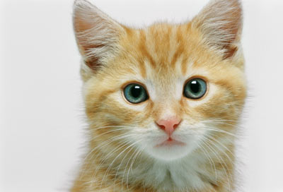







Why CNN for Image?
[Zeiler, M. D., ECCV 2014]
……
……
……
……
……
……
Represented as pixels
……
The most basic classifiers
Use 1st layer as module to build classifiers
Use 2nd layer as module ……
Can the network be simplified by considering the properties of images?

Slide 3
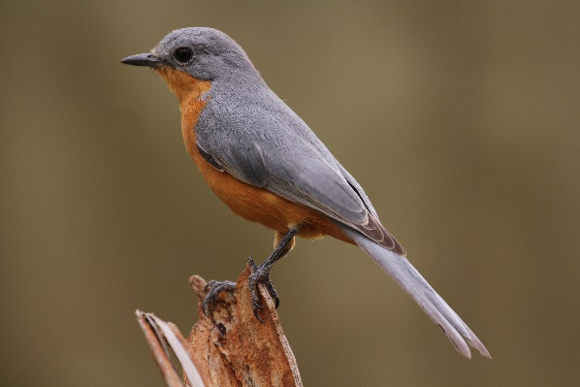
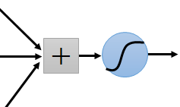
Why CNN for Image
Some patterns are much smaller than the whole image
A neuron does not have to see the whole image to discover the pattern.
Connecting to small region with less parameters
“beak” detector

Slide 4
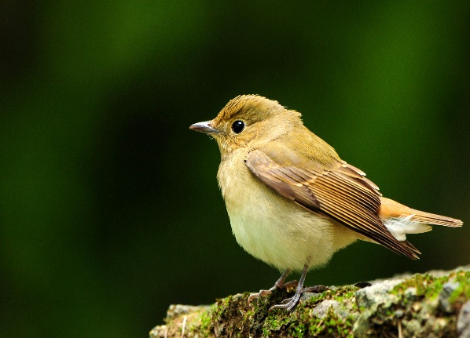
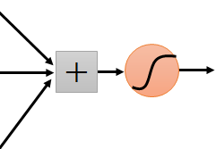
Why CNN for Image
The same patterns appear in different regions.
“upper-left beak” detector
Do almost the same thing
They can use the same set of parameters.
“middle beak” detector

Slide 5
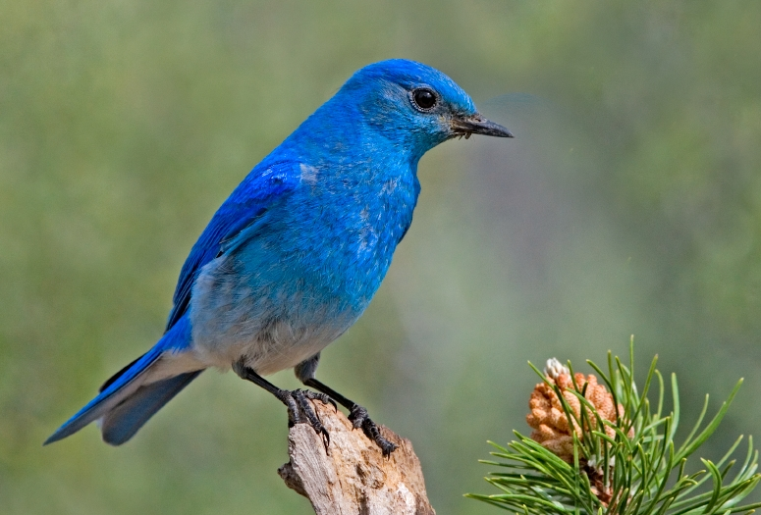

Why CNN for Image
Subsampling the pixels will not change the object
bird
bird
subsampling
We can subsample the pixels to make image smaller
Less parameters for the network to process the image

Slide 6
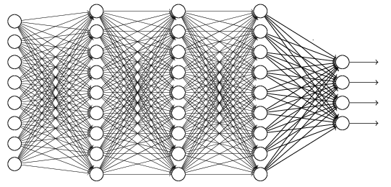
The whole CNN
cat dog ……
Convolution
Max Pooling
Can repeat many times
Fully Connected Feedforward network
Convolution
Max Pooling
Flatten

Slide 7
The whole CNN
Property 1
Some patterns are much smaller than the whole image
Convolution
Property 2
Max Pooling
The same patterns appear in different regions.
Can repeat many times
Property 3
Convolution
Subsampling the pixels will not change the object
Max Pooling
Flatten

Slide 8
The whole CNN
cat dog ……
Convolution
Max Pooling
Can repeat many times
Fully Connected Feedforward network
Convolution
Max Pooling
Flatten

Slide 9
CNN – Convolution
Those are the network parameters to be learned.
1 | -1 | -1
-1 | 1 | -1
-1 | -1 | 1
1 | 0 | 0 | 0 | 0 | 1
0 | 1 | 0 | 0 | 1 | 0
0 | 0 | 1 | 1 | 0 | 0
1 | 0 | 0 | 0 | 1 | 0
0 | 1 | 0 | 0 | 1 | 0
0 | 0 | 1 | 0 | 1 | 0
Filter 1
Matrix
-1 | 1 | -1
-1 | 1 | -1
-1 | 1 | -1
Filter 2
Matrix
……
6 x 6 image
Each filter detects a small pattern (3 x 3).
Property 1

Slide 10
CNN – Convolution
1 | -1 | -1
-1 | 1 | -1
-1 | -1 | 1
Filter 1
stride=1
1 | 0 | 0 | 0 | 0 | 1
0 | 1 | 0 | 0 | 1 | 0
0 | 0 | 1 | 1 | 0 | 0
1 | 0 | 0 | 0 | 1 | 0
0 | 1 | 0 | 0 | 1 | 0
0 | 0 | 1 | 0 | 1 | 0
3
-1
6 x 6 image

Slide 11
CNN – Convolution
1 | -1 | -1
-1 | 1 | -1
-1 | -1 | 1
Filter 1
If stride=2
1 | 0 | 0 | 0 | 0 | 1
0 | 1 | 0 | 0 | 1 | 0
0 | 0 | 1 | 1 | 0 | 0
1 | 0 | 0 | 0 | 1 | 0
0 | 1 | 0 | 0 | 1 | 0
0 | 0 | 1 | 0 | 1 | 0
3
-3
We set stride=1 below
6 x 6 image

Slide 12
CNN – Convolution
1 | -1 | -1
-1 | 1 | -1
-1 | -1 | 1
Filter 1
stride=1
1 | 0 | 0 | 0 | 0 | 1
0 | 1 | 0 | 0 | 1 | 0
0 | 0 | 1 | 1 | 0 | 0
1 | 0 | 0 | 0 | 1 | 0
0 | 1 | 0 | 0 | 1 | 0
0 | 0 | 1 | 0 | 1 | 0
3
-1
-3
-1
-3
1
0
-3
-3
-3
0
1
3
-2
-2
-1
6 x 6 image
Property 2

Slide 13
CNN – Convolution
-1 | 1 | -1
-1 | 1 | -1
-1 | 1 | -1
Filter 2
stride=1
Do the same process for every filter
1 | 0 | 0 | 0 | 0 | 1
0 | 1 | 0 | 0 | 1 | 0
0 | 0 | 1 | 1 | 0 | 0
1 | 0 | 0 | 0 | 1 | 0
0 | 1 | 0 | 0 | 1 | 0
0 | 0 | 1 | 0 | 1 | 0
3
-1
-3
-1
-1
-1
-1
-1
-3
1
0
-3
-1
-1
-2
1
Feature
Map
-3
-3
0
1
-1
-1
-2
1
3
-2
-2
-1
6 x 6 image
-1
0
-4
3
4 x 4 image

Slide 14
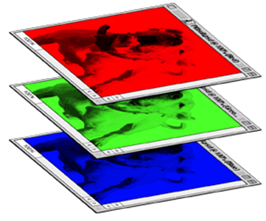
CNN – Colorful image
1 | -1 | -1
-1 | 1 | -1
-1 | -1 | 1
-1 | 1 | -1
-1 | 1 | -1
-1 | 1 | -1
1 | -1 | -1
-1 | 1 | -1
-1 | -1 | 1
-1 | 1 | -1
-1 | 1 | -1
-1 | 1 | -1
1 | -1 | -1
-1 | 1 | -1
-1 | -1 | 1
-1 | 1 | -1
-1 | 1 | -1
-1 | 1 | -1
Filter 1
Filter 2
Colorful image
1 | 0 | 0 | 0 | 0 | 1
0 | 1 | 0 | 0 | 1 | 0
0 | 0 | 1 | 1 | 0 | 0
1 | 0 | 0 | 0 | 1 | 0
0 | 1 | 0 | 0 | 1 | 0
0 | 0 | 1 | 0 | 1 | 0
1 | 0 | 0 | 0 | 0 | 1
0 | 1 | 0 | 0 | 1 | 0
0 | 0 | 1 | 1 | 0 | 0
1 | 0 | 0 | 0 | 1 | 0
0 | 1 | 0 | 0 | 1 | 0
0 | 0 | 1 | 0 | 1 | 0
1 | 0 | 0 | 0 | 0 | 1
0 | 1 | 0 | 0 | 1 | 0
0 | 0 | 1 | 1 | 0 | 0
1 | 0 | 0 | 0 | 1 | 0
0 | 1 | 0 | 0 | 1 | 0
0 | 0 | 1 | 0 | 1 | 0

Slide 15
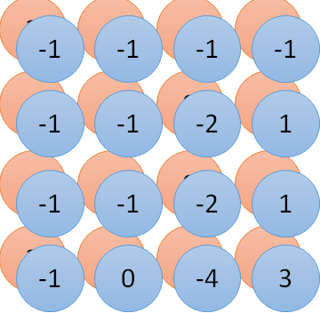
Convolution v.s. Fully Connected
1 | 0 | 0 | 0 | 0 | 1
0 | 1 | 0 | 0 | 1 | 0
0 | 0 | 1 | 1 | 0 | 0
1 | 0 | 0 | 0 | 1 | 0
0 | 1 | 0 | 0 | 1 | 0
0 | 0 | 1 | 0 | 1 | 0
1 | -1 | -1
-1 | 1 | -1
-1 | -1 | 1
-1 | 1 | -1
-1 | 1 | -1
-1 | 1 | -1
convolution
image
1 | 0 | 0 | 0 | 0 | 1
0 | 1 | 0 | 0 | 1 | 0
0 | 0 | 1 | 1 | 0 | 0
1 | 0 | 0 | 0 | 1 | 0
0 | 1 | 0 | 0 | 1 | 0
0 | 0 | 1 | 0 | 1 | 0
Fully-connected
……
……

Slide 16
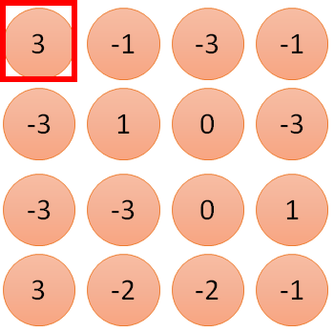
1 | -1 | -1
-1 | 1 | -1
-1 | -1 | 1
1:
1
Filter 1
2:
0
3:
0
3
4:
0
1 | 0 | 0 | 0 | 0 | 1
0 | 1 | 0 | 0 | 1 | 0
0 | 0 | 1 | 1 | 0 | 0
1 | 0 | 0 | 0 | 1 | 0
0 | 1 | 0 | 0 | 1 | 0
0 | 0 | 1 | 0 | 1 | 0
…
7:
0
8:
1
9:
0
10:
0
…
13:
0
6 x 6 image
14:
0
Less parameters!
15:
Only connect to 9 input, not fully connected
1
16:
1
…

Slide 17
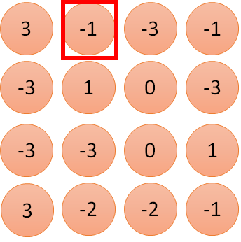
1 | -1 | -1
-1 | 1 | -1
-1 | -1 | 1
1:
1
Filter 1
2:
0
3:
0
3
4:
0
1 | 0 | 0 | 0 | 0 | 1
0 | 1 | 0 | 0 | 1 | 0
0 | 0 | 1 | 1 | 0 | 0
1 | 0 | 0 | 0 | 1 | 0
0 | 1 | 0 | 0 | 1 | 0
0 | 0 | 1 | 0 | 1 | 0
…
7:
0
8:
1
-1
9:
0
10:
0
…
13:
0
6 x 6 image
14:
0
Less parameters!
15:
1
16:
1
Shared weights
Even less parameters!
…

Slide 18
The whole CNN
cat dog ……
Convolution
Max Pooling
Can repeat many times
Fully Connected Feedforward network
Convolution
Max Pooling
Flatten

Slide 19
CNN – Max Pooling
1 | -1 | -1
-1 | 1 | -1
-1 | -1 | 1
-1 | 1 | -1
-1 | 1 | -1
-1 | 1 | -1
Filter 1
Filter 2
3
-1
-3
-1
-1
-1
-1
-1
-3
1
0
-3
-1
-1
-2
1
-3
-3
0
1
-1
-1
-2
1
3
-2
-2
-1
-1
0
-4
3

Slide 20
CNN – Max Pooling
New image
but smaller
1 | 0 | 0 | 0 | 0 | 1
0 | 1 | 0 | 0 | 1 | 0
0 | 0 | 1 | 1 | 0 | 0
1 | 0 | 0 | 0 | 1 | 0
0 | 1 | 0 | 0 | 1 | 0
0 | 0 | 1 | 0 | 1 | 0
Conv
3
0
-1
1
Max
Pooling
3
1
0
3
2 x 2 image
6 x 6 image
Each filter
is a channel

Slide 21
The whole CNN
3
0
-1
1
Convolution
3
1
0
3
Max Pooling
Can repeat many times
A new image
Convolution
Smaller than the original image
The number of the channel is the number of filters
Max Pooling

Slide 22
The whole CNN
cat dog ……
Convolution
Max Pooling
A new image
Fully Connected Feedforward network
Convolution
Max Pooling
A new image
Flatten

Slide 23
Flatten
3
0
1
3
0
-1
1
3
3
1
-1
0
3
Flatten
1
Fully Connected Feedforward network
0
3

Slide 24

CNN in Keras
Only modified the network structure and input format (vector -> 3-D tensor)
input
Convolution
1 | -1 | -1
-1 | 1 | -1
-1 | -1 | 1
-1 | 1 | -1
-1 | 1 | -1
-1 | 1 | -1
There are 25 3x3 filters.
……
Max Pooling
Input_shape = ( 1 , 28 , 28 )
1: black/weight, 3: RGB
28 x 28 pixels
Convolution
3
-1
3
Max Pooling
-3
1

Slide 25
CNN in Keras
Only modified the network structure and input format (vector -> 3-D tensor)
input
1 x 28 x 28
Convolution
How many parameters for each filter?
9
25 x 26 x 26
Max Pooling
25 x 13 x 13
Convolution
How many parameters for each filter?
225
50 x 11 x 11
Max Pooling
50 x 5 x 5

Slide 26
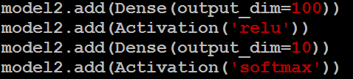
CNN in Keras
Only modified the network structure and input format (vector -> 3-D tensor)
input
1 x 28 x 28
output
Convolution
25 x 26 x 26
Fully Connected Feedforward network
Max Pooling
25 x 13 x 13
Convolution
50 x 11 x 11
Max Pooling
1250
50 x 5 x 5
Flatten

Slide 27
Live Demo

Slide 28

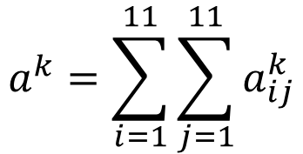

What does CNN learn?
The output of the k-th filter is a 11 x 11 matrix.
x
input
Degree of the activation of the k-th filter:
$$a^{k}=\sum_{i=1}^{11}{\sum_{j=1}^{11}{a_{ij}^{k}}}$$
25 3x3 filters
Convolution
$$x^{∗}=arg\max_{x}{a^{k}}$$
(gradient ascent)
11
Max Pooling
3
-1
……
-1
50 3x3 filters
$$a_{ij}^{k}$$
Convolution
-3
1
……
-3
11
50 x 11 x 11
……
……
……
Max Pooling
3
-2
……
-1

Slide 29

What does CNN learn?
The output of the k-th filter is a 11 x 11 matrix.
input
Degree of the activation of the k-th filter:
$$a^{k}=\sum_{i=1}^{11}{\sum_{j=1}^{11}{a_{ij}^{k}}}$$
25 3x3 filters
Convolution
$$x^{∗}=arg\max_{x}{a^{k}}$$
(gradient ascent)
Max Pooling
50 3x3 filters
Convolution
50 x 11 x 11
Max Pooling
For each filter

Slide 30

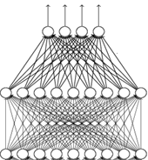


What does CNN learn?
input
Find an image maximizing the output of neuron:
Convolution
$$x^{∗}=arg\max_{x}{a^{j}}$$
Max Pooling
Convolution
Max Pooling
flatten
Each figure corresponds to a neuron
$$a_{j}$$

Slide 31



What does CNN learn?
input
$$x^{∗}=arg\max_{x}{y^{i}}$$
Can we see digits?
Convolution
Max Pooling
0
1
2
Convolution
Max Pooling
3
4
5
flatten
6
7
8
Deep Neural Networks are Easily Fooled
https://www.youtube.com/watch?v=M2IebCN9Ht4
$$y_{i}$$

Slide 32

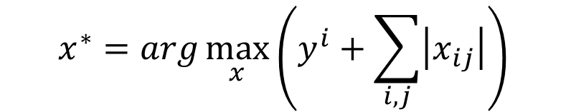

What does CNN learn?
Over all pixel values
$$x^{∗}=arg\max_{x}\left(y^{i}+\sum_{i,j}{\left|x_{ij}\right|}\right)$$
$$x^{∗}=arg\max_{x}{y^{i}}$$
0
1
2
0
1
2
3
4
5
3
4
5
6
7
8
6
7
8

Slide 33
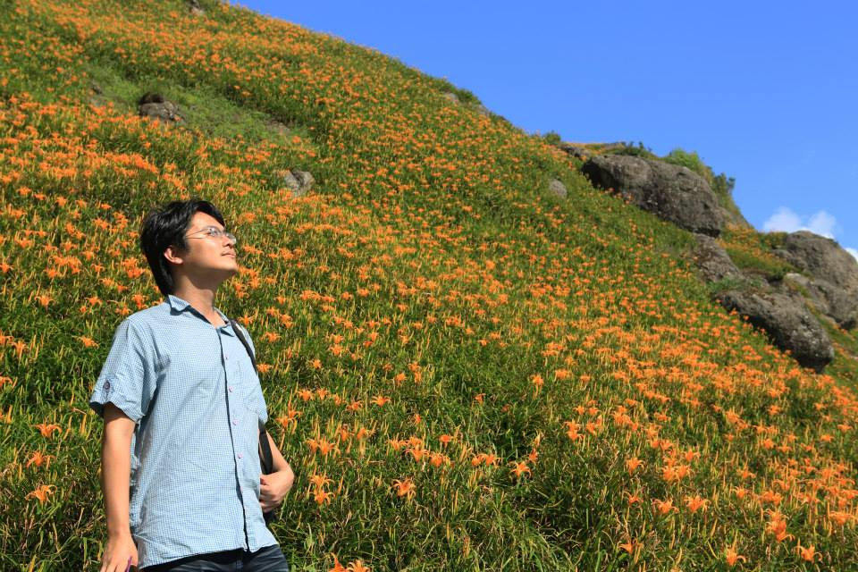

Deep Dream
CNN
Modify image
Given a photo, machine adds what it sees ……
$$\left[\begin{aligned}3.9 \\ −1.5 \\ 2.3 \\ ⋮\end{aligned}\right]$$
CNN exaggerates what it sees
http://deepdreamgenerator.com/
Notes:
http://speech.ee.ntu.edu.tw/dokuwiki/lib/exe/fetch.php?media=speech:meeting:paper_report:paper_report_2015-08-12.pdf

Slide 34

Deep Dream
Given a photo, machine adds what it sees ……
http://deepdreamgenerator.com/

Slide 35
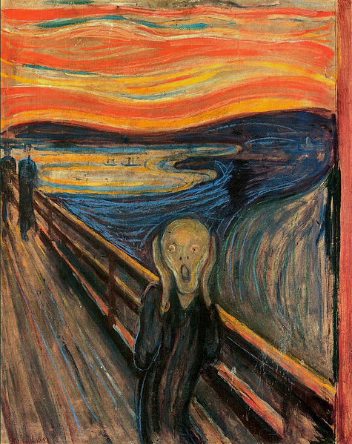
Deep Style
Given a photo, make its style like famous paintings
https://dreamscopeapp.com/

Slide 36
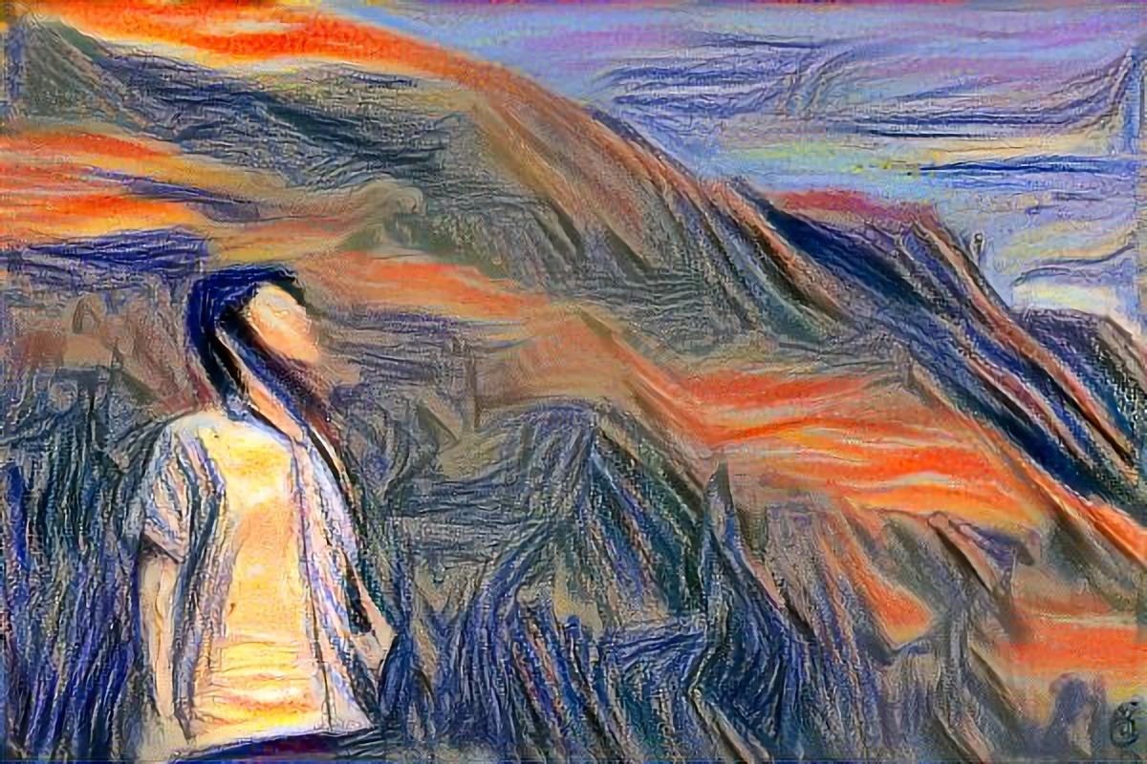
Deep Style
Given a photo, make its style like famous paintings
https://dreamscopeapp.com/

Slide 37

Deep Style
CNN
CNN
A Neural Algorithm of Artistic Style
https://arxiv.org/abs/1508.06576
content
style
CNN
?

Slide 38
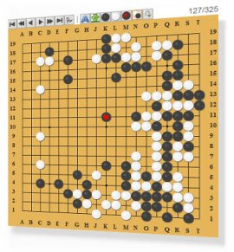
More Application: Playing Go
Network
Next move
(19 x 19 positions)
19 x 19 matrix (image)
19 x 19 vector
19 x 19 vector
Fully-connected feedforward network can be used
Black: 1
white: -1
none: 0
But CNN performs much better.

Slide 39
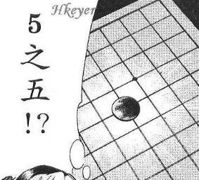


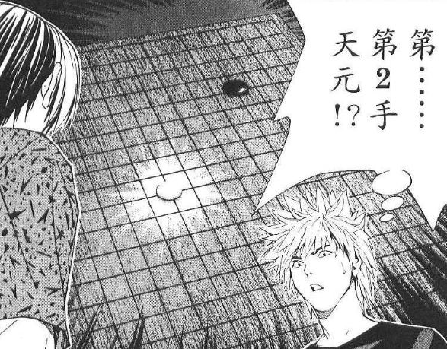
More Application: Playing Go
record of previous plays
Training:
黑: 5之五
白: 天元
黑: 五之5 …
Target:
“天元” = 1
else = 0
CNN
Target:
“五之 5” = 1
else = 0
CNN

Slide 40
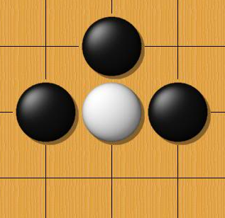
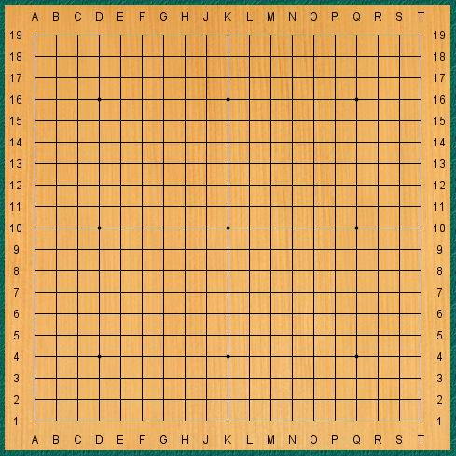
Why CNN for playing Go?
Some patterns are much smaller than the whole image
The same patterns appear in different regions.
Alpha Go uses 5 x 5 for first layer

Slide 41
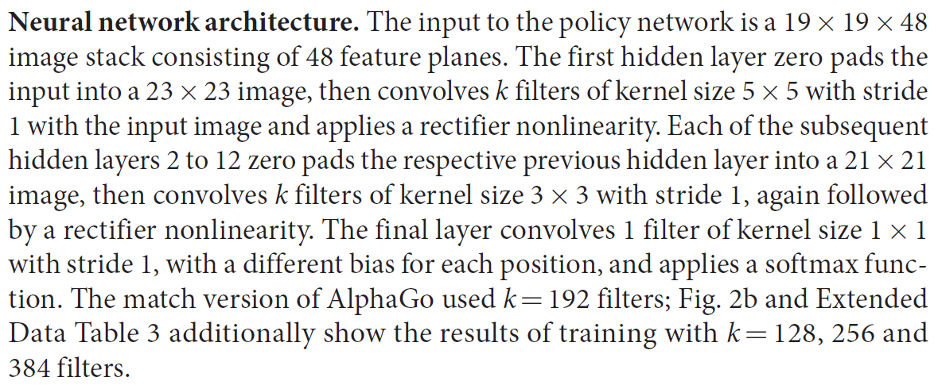
Why CNN for playing Go?
Subsampling the pixels will not change the object
Max Pooling
How to explain this???
Alpha Go does not use Max Pooling ……
Notes:
Very good example for desing your network

Slide 42
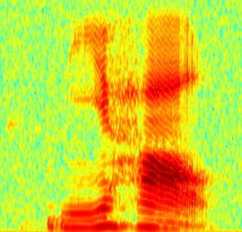
More Application: Speech
The filters move in the frequency direction.
CNN
Frequency
Image
Time
Spectrogram

Slide 43
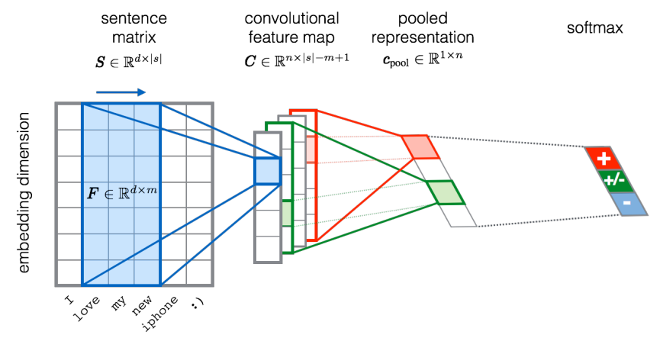
More Application: Text
?
Source of image: http://citeseerx.ist.psu.edu/viewdoc/download?doi=10.1.1.703.6858&rep=rep1&type=pdf

Slide 44
To learn more ……
The methods of visualization in these slides
https://blog.keras.io/how-convolutional-neural-networks-see-the-world.html
More about visualization
http://cs231n.github.io/understanding-cnn/
Very cool CNN visualization toolkit
http://yosinski.com/deepvis
http://scs.ryerson.ca/~aharley/vis/conv/
The 9 Deep Learning Papers You Need To Know About
https://adeshpande3.github.io/adeshpande3.github.io/The-9-Deep-Learning-Papers-You-Need-To-Know-About.html

Slide 45
To learn more ……
How to let machine draw an image
PixelRNN
https://arxiv.org/abs/1601.06759
Variation Autoencoder (VAE)
https://arxiv.org/abs/1312.6114
Generative Adversarial Network (GAN)
http://arxiv.org/abs/1406.2661

